Slide 1
COIMBATORE BBRANCH
Giving to MSME Dreams

Slide 2
Serving MSMEs to the core
Machinery/Equipment Finance
25000 Cr
O/s
Portfolio
Project Finance – Capex Requirements
13750+
Customers
Hotels, Restaurants – Interior and other capex requirements
15
Regional Offices
118
Branch
Offices
3
ELSCs
Working Capital/ Overdraft
Green Finance – Energy Efficient Projects

Slide 3
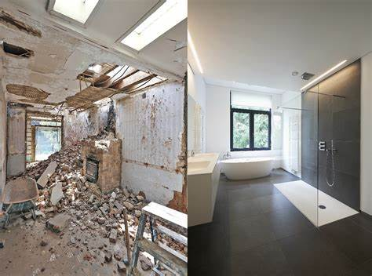
Term loan assistance for Modernization & Renovation of Hotels, Restaurants etc.
Assistance for tangible assets incl. light assets like interiors, equipment, furniture and civil work renovation.
Eligibility
MSMEs having 3 years of operations with cash profits and net profit in last FY.
MORE
Mandatory CGTMSE cover for Mirco & Small Enterprises
Flexible security norms for loans not covered under CGTMSE.
Assistance Upto
` 5 crore with lower promoter contribution at 20% of Project cost
MCLR Linked Attractive RoI
“For upgrading existing facilities.…”

Slide 4
Assistance for regular working capital needs of the business.
Eligibility
Existing MSME not availing CC/OD from any other bank.
Greenfield entity where term loan is also considered.
Not considered on stand alone basis.
Arrangement with Yes, IDBI & City Union bank for maintaining Working capital account.
Working Capital
ToD and Adhoc facilities also available
MCLR Linked Attractive RoI
“For day-to-day business requirements”

Slide 5
Assistance for any business-related expenditure
Loan upto 60% of market value of collateral security.
Loan in Foreign currency also available.
Eligibility
3 Years of Operations with cash profits
Net profit in two of the past 3 FYs
Secured Business Loan
Flexible Repayment Upto 10 Years
Assistance Upto
` 10 Crore
MCLR Linked Attractive RoI
“Quick Business Loan” against Immovable Property

Slide 6
Digitizing MSME Credit
Digital Document Execution
(E-Stamping
& Signing)
Enhanced Customer Due Diligence tools
Online Loan
Application
Quick
Sanction
Customer Engagement & Dedicated RM

Slide 7
Thank you
@sidbiofficial
@sidbiofficial
@sidbiofficial
For feedback/suggestions do reach out us at 9725730035/9930181855

